Slide 1
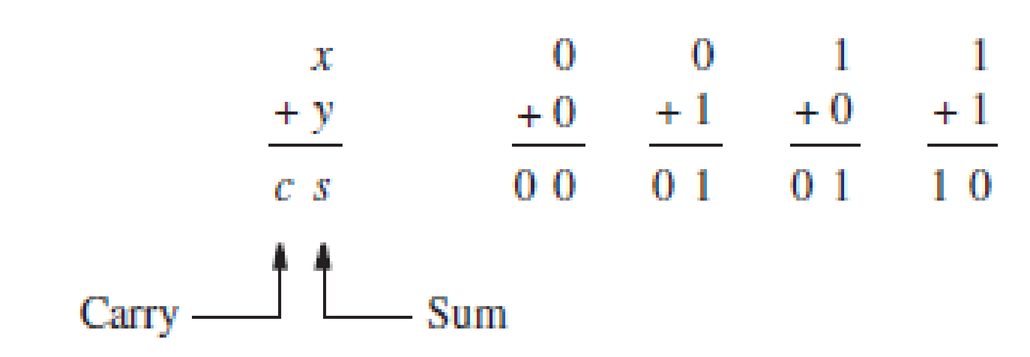
ARITHMETIC CIRCUITS
Addition of Unsigned Numbers
The one-bit addition entails four possible combinations,

Slide 2
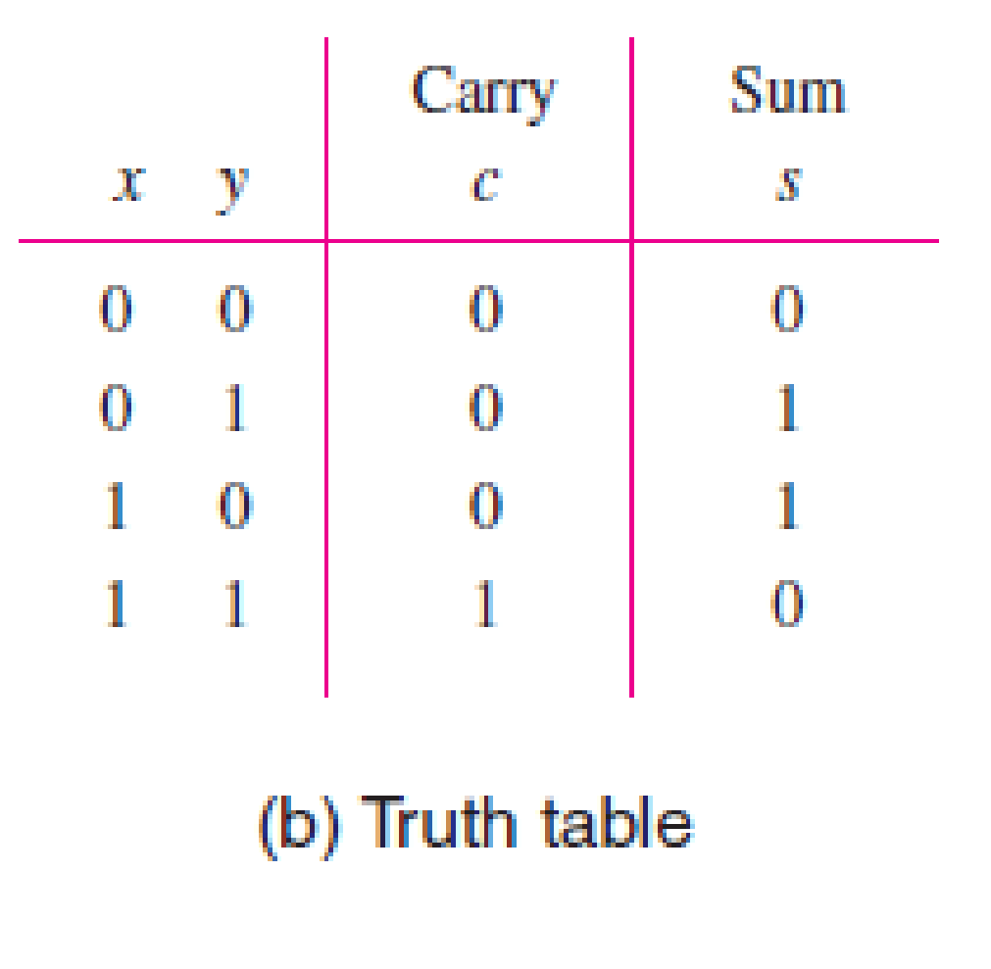
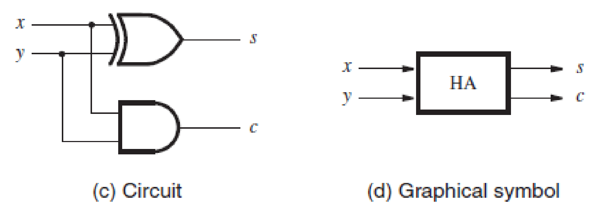
The sum bit s is the XOR function. The carry c is the AND function of inputs x and y. A circuit realization of these functions is shown in Fig. c. This circuit, which implements the addition of only two bits, is called a half-adder.

Slide 3
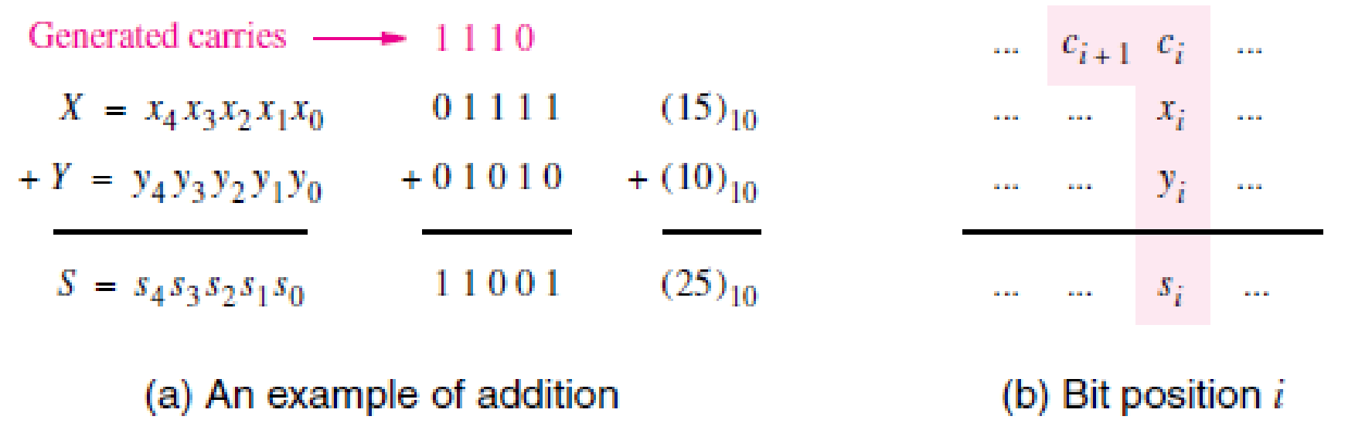
Multibit Addition
for each bit position i, the addition operation may include a carry-in from bit position i − 1.

Slide 4
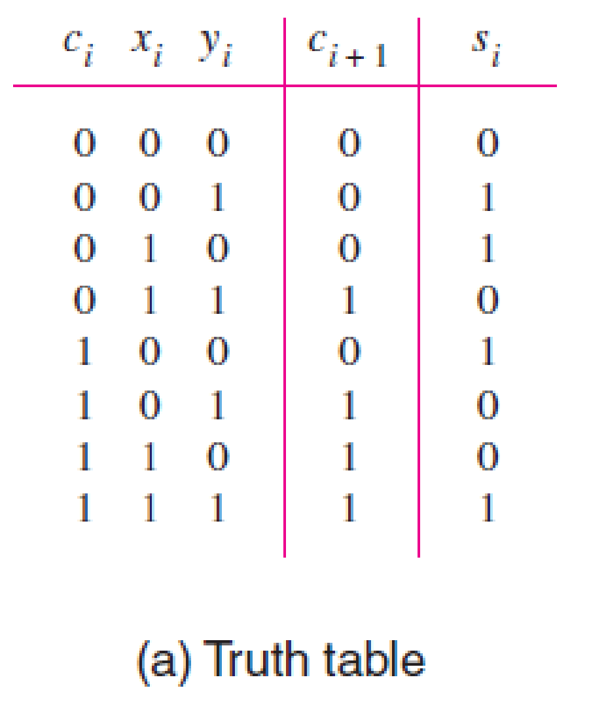
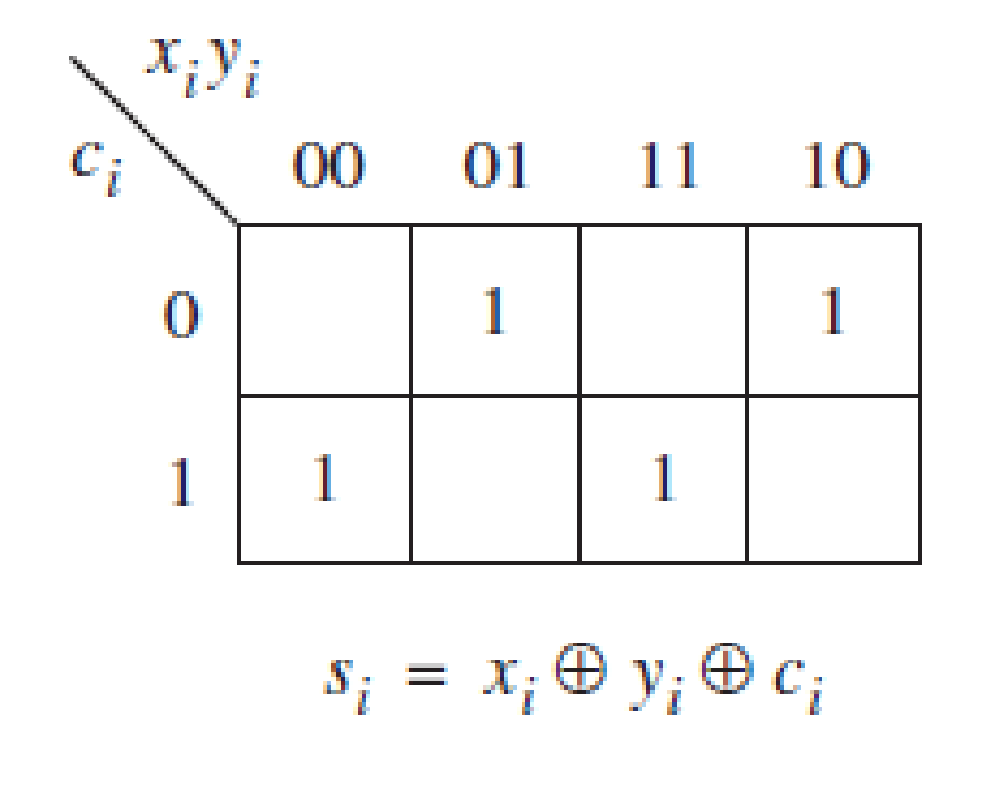
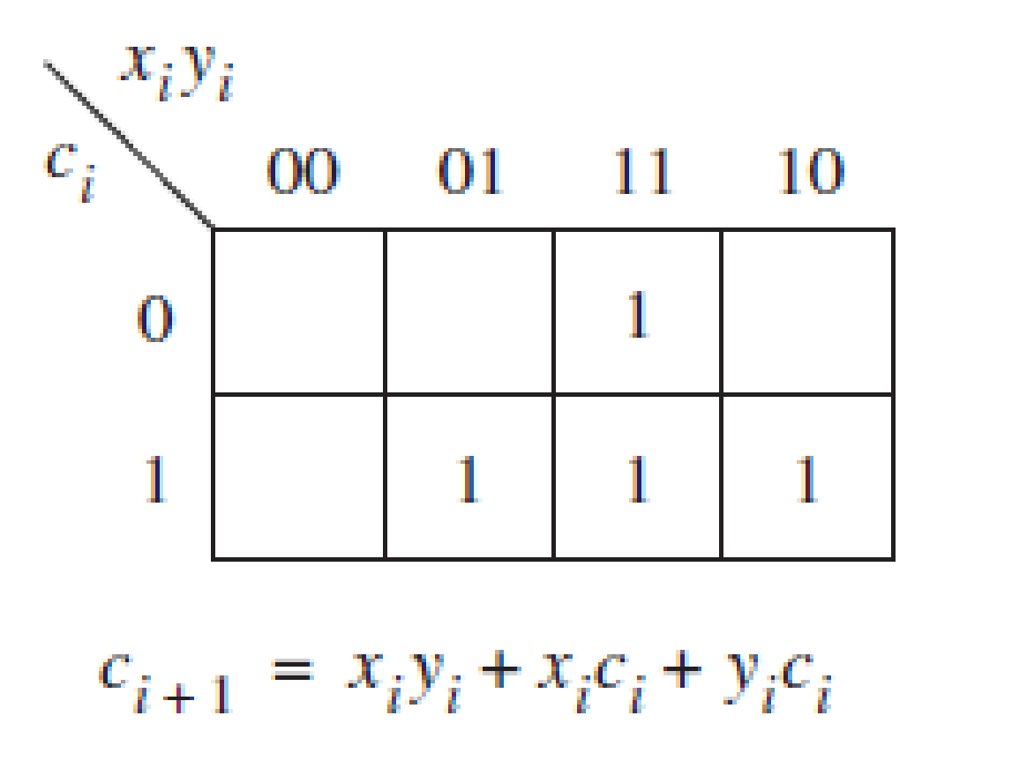
This observation leads to the design of a logic circuit that
has three inputs xi , yi , and ci , and produces the two outputs si and ci+1.

Slide 5
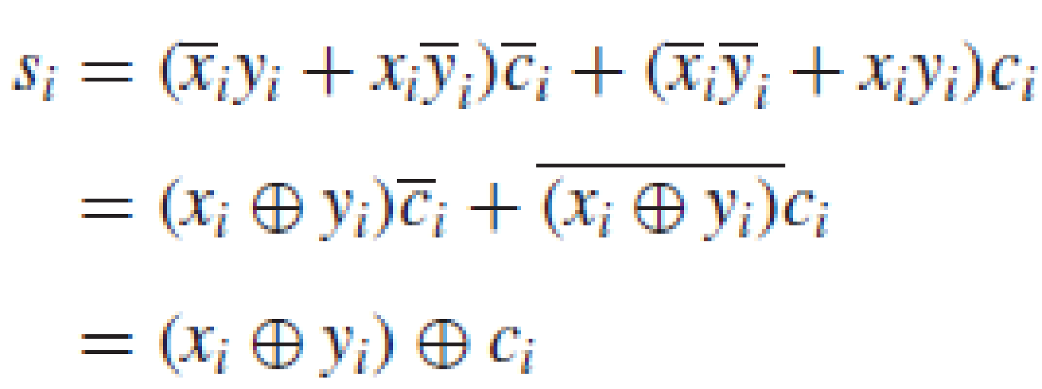
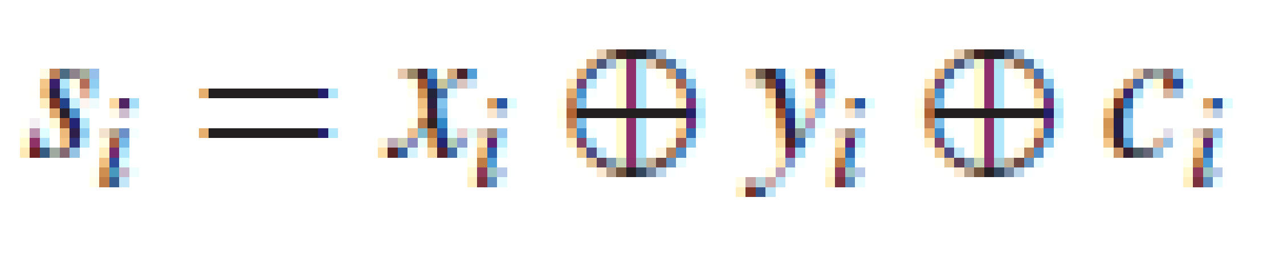

Slide 6
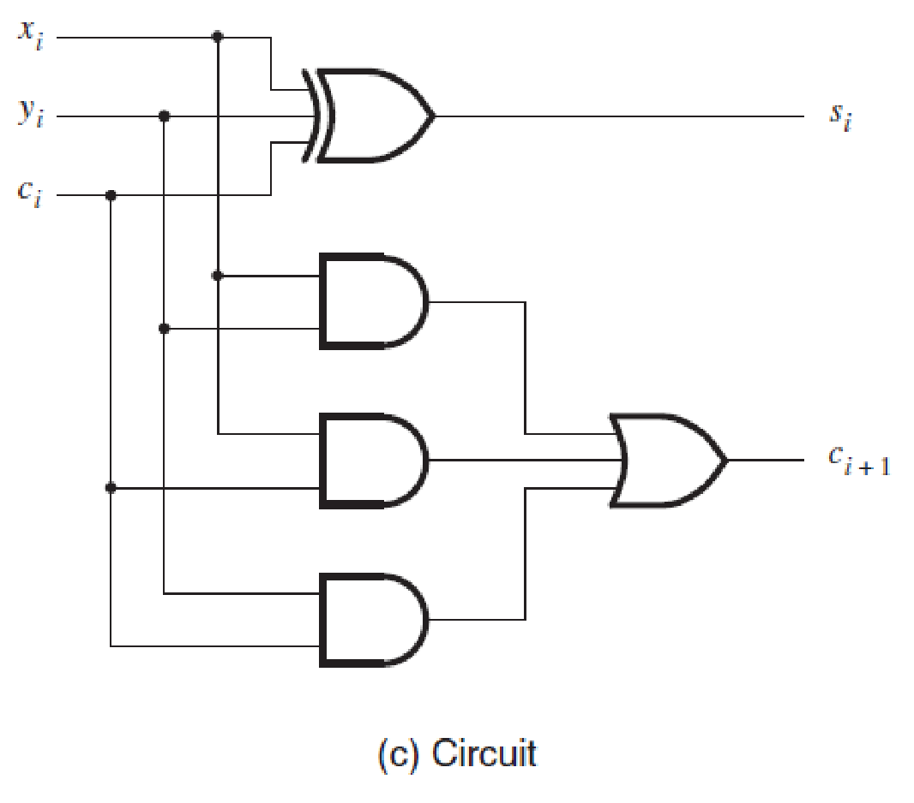
This circuit is known as a full-adder.

Slide 7
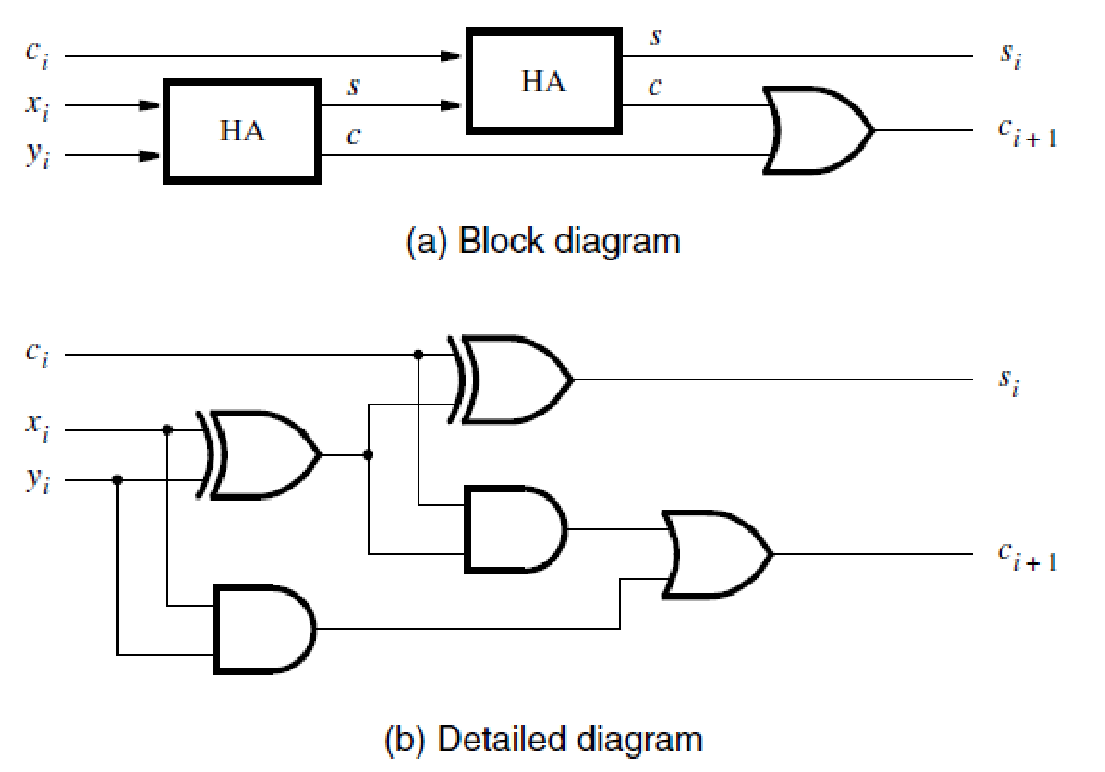
Decomposed Full-Adder

Slide 8
S1=xi XOR yi
C1=xiyi
S2=Si=S1 XOR ci = xi XOR yi XOR ci
C2=S1ci = (xi XOR yi)ci
= xi’yici + xiyi’ci
Ci+1= xiyi + xi’yici + xiyi’ci
= xiyi(ci+ci’) + xi’yici + xiyi’ci
= xiyici +xiyici’ + xi’yici + xiyi’ci
=xiyi +yici + xici

Slide 9
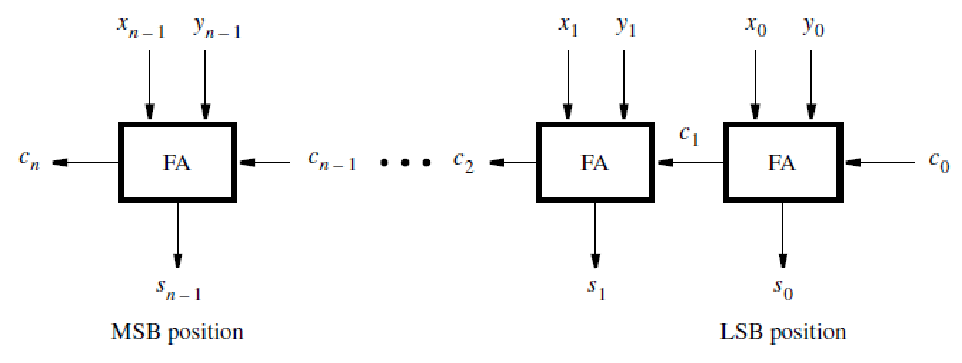
Ripple-Carry Adder
For each bit position we can use a full-adder circuit, connected as shown in Figure

Slide 10
When the operands X and Y are applied as inputs to the adder, it takes some time before the output sum, S, is valid. Each full-adder introduces a certain delay before its si and ci+1 outputs are valid. Let this delay be denoted as ∆t.
Thus the carry-out from the first stage, c1, arrives at the second stage ∆t after the application of the x0 and y0 inputs. The carry-out from the second stage, c2, arrives at the third stage with a 2∆t delay, and so on.
The signal cn−1 is valid after a delay of (n − 1) ∆t, which means that the complete sum is available after a delay of n∆t. Because of the way the carry signals “ripple” through the full-adder stages, the circuit is called a ripple-carry adder.

Slide 11
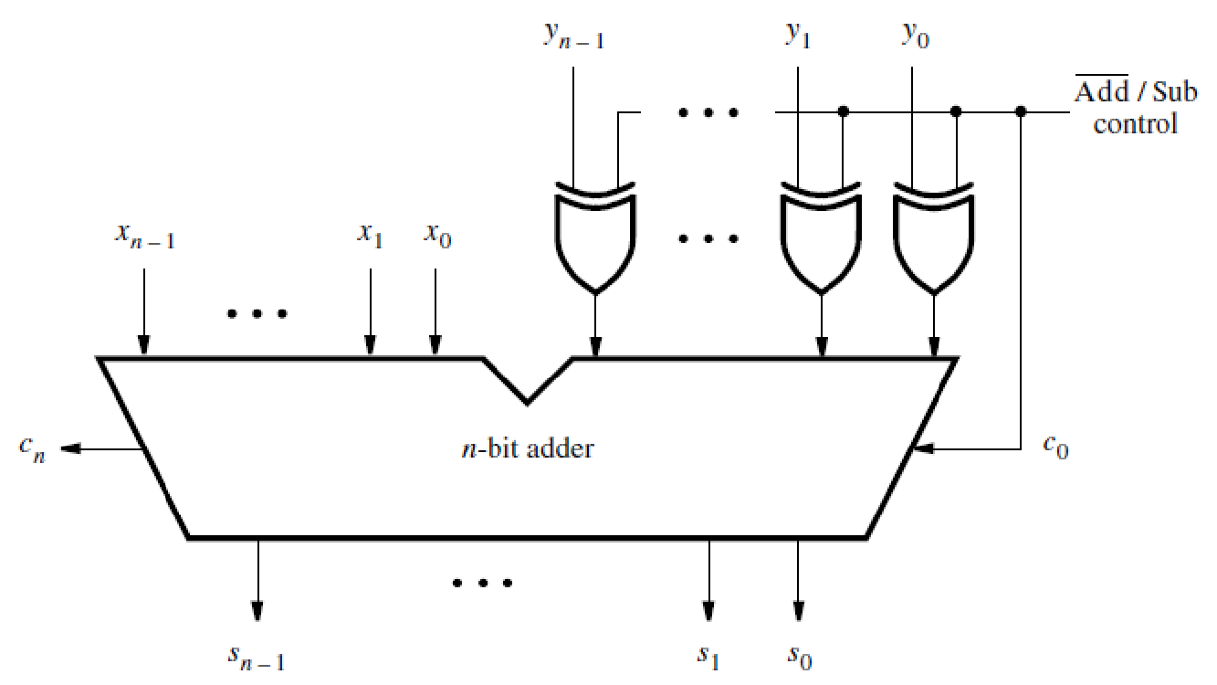
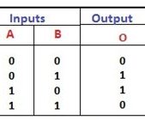
Adder and Subtractor Unit
A XOR B

Slide 12
When Add/Sub = 0, it performs X + Y.
When Add/Sub = 1, it performs
X + Y’ + 1
= X + 2’s complement of Y
= X - Y

Slide 13
Arithmetic Overflow
The result of addition or subtraction is supposed to fit within the significant bits used to represent the numbers. If n bits are used to represent signed numbers, then the result must be in the range −2^{n−1} to 2^{n−1} − 1. If the result does not fit in this range, then we say that arithmetic overflow has occurred.

Slide 14
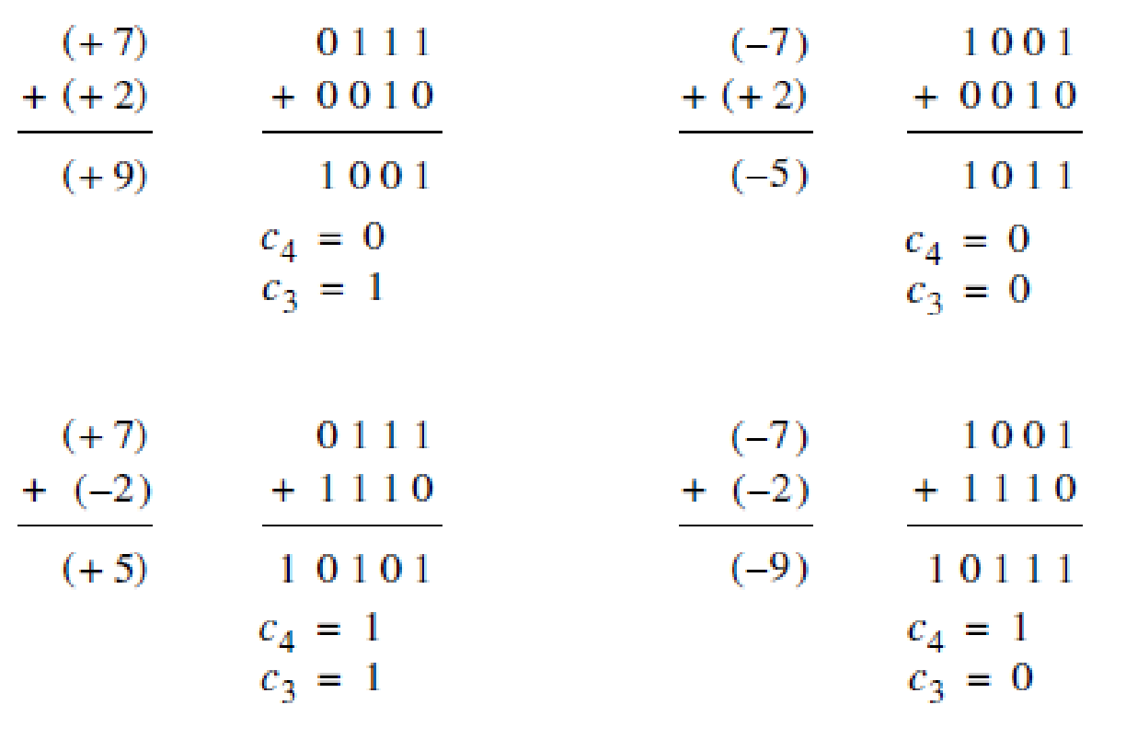

Slide 15
We are using four-bit numbers. If both numbers have the same sign, the magnitude of the result is 9, which cannot be represented with 4 bits in 2’s complement representation. Therefore, overflow occurs. When the numbers have opposite signs, there is no overflow. The key to determine whether overflow occurs is the carry-out from the sign-bit position, called c₄ in the figure and from the previous bit position, called c_{3.} The figure indicates that overflow occurs when these carry-outs have different values, and a correct sum is produced when they have the same value. Indeed, this is true in general for both addition and subtraction of 2’s-complement numbers.

Slide 16
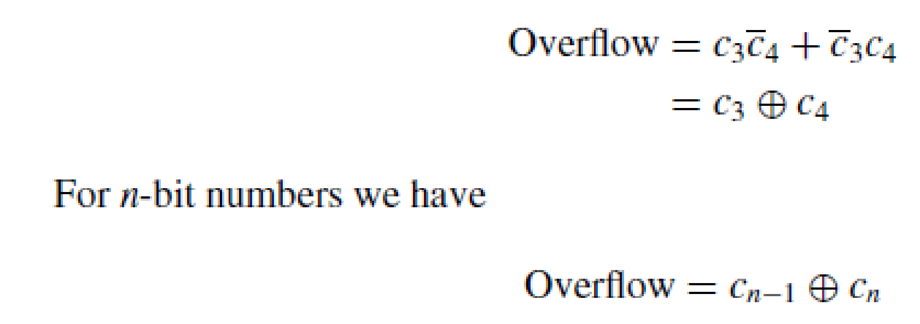
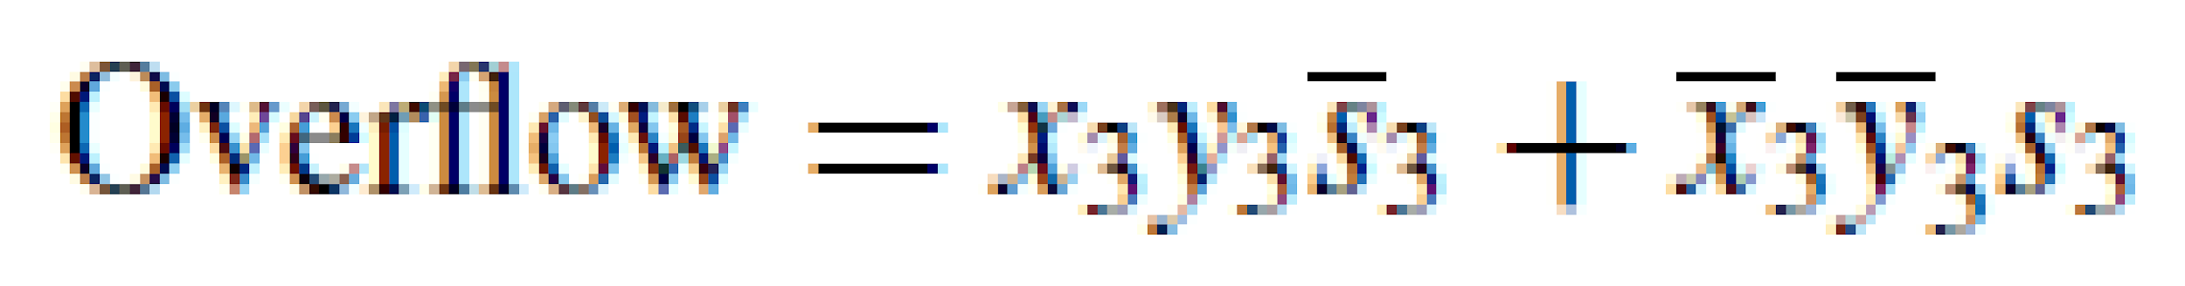
An alternative and more intuitive way of detecting the arithmetic overflow is to observe that overflow occurs if both summands have the same sign but the resulting sum has a different sign. Let X = x3x2x1x0 and Y = y3y2y1y0 represent four-bit 2’s-complement numbers, and let S = s3s2s1s0 be the sum S = X + Y . Then

Slide 17
The carry-out and overflow signals indicate whether the result of a given addition is too large to fit into the number of bits available to represent the sum. The carry-out is meaningful only when unsigned numbers are involved, while the overflow is meaningful only in the case of signed numbers.

Slide 18
Fast Adders
The addition and subtraction of numbers are fundamental operations that are performed frequently in the course of a computation. The speed with which these operations are performed has a strong impact on the overall performance of a computer.

Slide 19
Let us take a closer look at the speed of the adder/subtractor unit. We are interested in the largest delay from the time the operands X and Y are presented as inputs, until the time all bits of the sum S and the final carry-out, c_{n}, are valid.
The delay for the carry-out signal in the full adder circuit, ∆t, is equal to two gate delays.
The final result of the addition will be valid after a delay of n∆t, which is equal to 2n gate delays.

Slide 20
In addition to the delay in the ripple-carry path, there is also a delay in the XOR gates that feed either the true or complemented value of Y to the adder inputs. If this delay is equal to one gate delay, then the total delay of the circuit is 2n + 1 gate delays. For a large n, say n = 32 or n = 64, the delay would lead to unacceptably poor performance.
The longest delay is along the path from the yi input, through the XOR gate and through the carry circuit of each adder stage. The longest delay is often referred to as the critical-path delay, and the path that causes this
delay is called the critical path.

Slide 21
Carry-Lookahead Adder
To reduce the delay caused by the effect of carry propagation through the ripple-carry adder, we can attempt to evaluate quickly for each stage whether the carry-in from the previous stage will have a value 0 or 1. If a correct evaluation can be made in a relatively short time, then the performance of the complete adder will be improved.

Slide 22



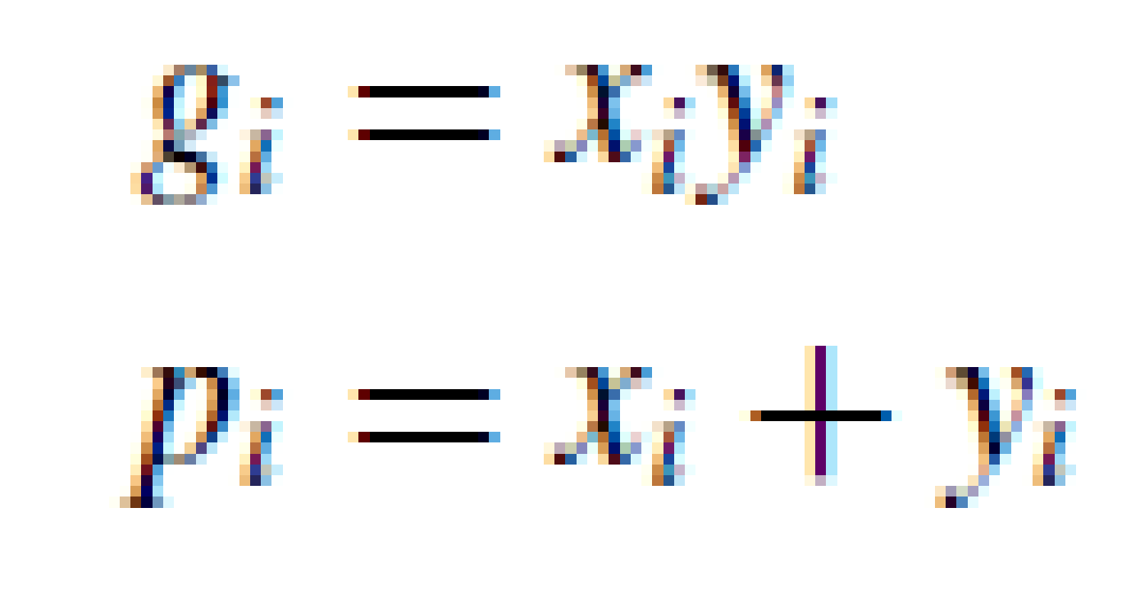
g_{i} is called the generate function.
p_{i} is called the propagate function.

Slide 23
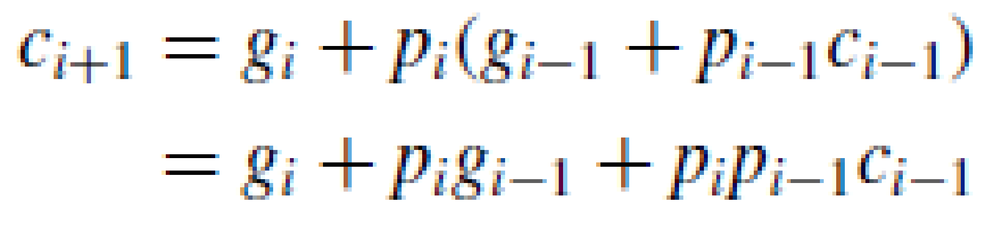
Expanding in terms of stage i − 1 gives
The same expansion for other stages, ending with stage 0, gives
This expression represents a two-level AND-OR circuit in which c_{i+1} is evaluated very quickly. An adder based on this expression is called a carry-lookahead adder.

Slide 24
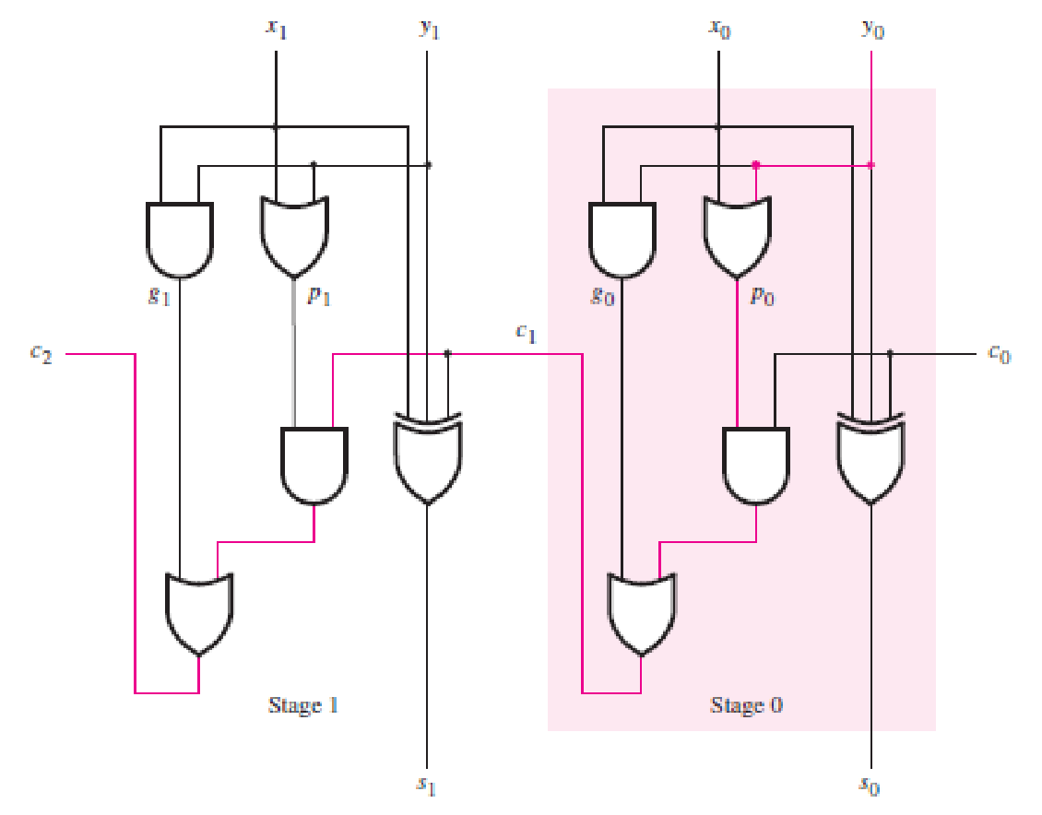
The critical path is from inputs x0 and y0 to the output c2. It passes through five gates, The path in other stages of an n-bit adder is the same as in stage 1. Therefore, the total number of gate delays along the critical path is 2n + 1.
A ripple-carry adder

Slide 25
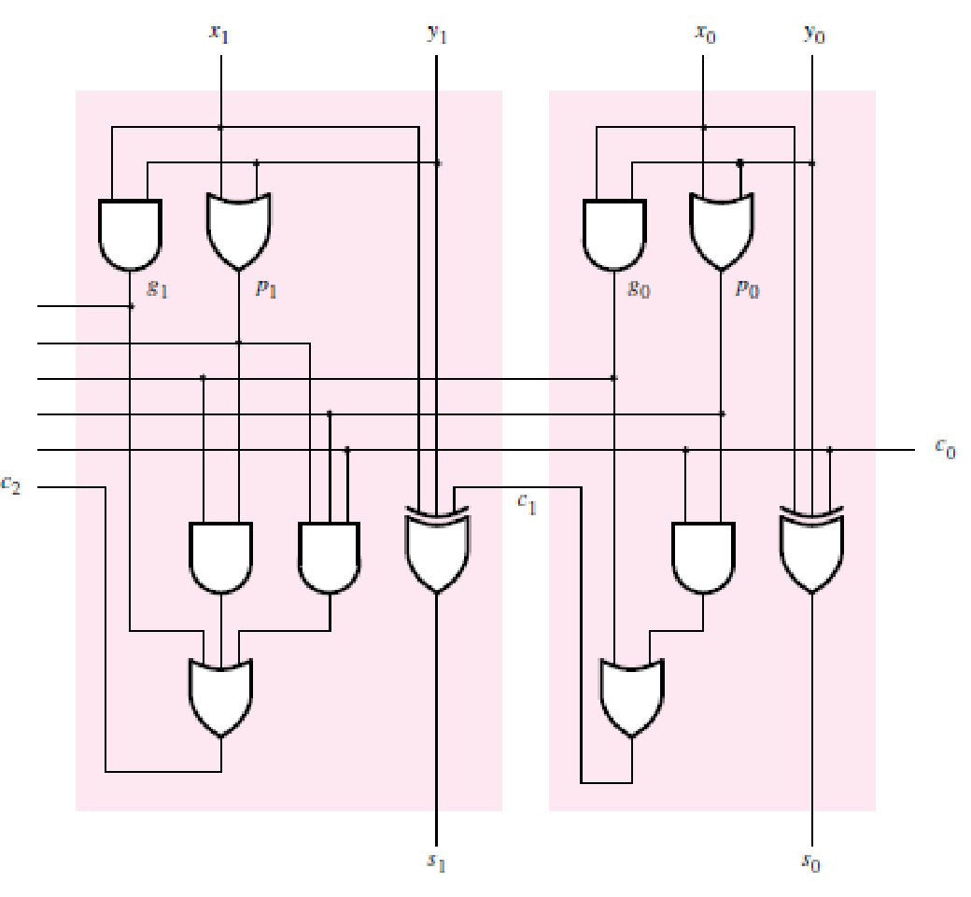
All carry signals are produced after three gate delays: one gate delay is needed to produce the generate and propagate signals g0, g1, p0, and p1, and two more gate delays are needed to produce c1 and c2 concurrently. Extending the circuit to n bits, the final carry-out signal cn would also be produced after only three gate delays.
The first two stages of a carry-lookahead adder

Slide 26
The total delay in the n-bit carry-lookahead adder is four gate delays. The values of all gi and pi signals are determined after one gate delay. It takes two more gate delays to evaluate all carry signals. Finally, it takes one more gate delay (XOR) to generate all sum bits. The key to the good performance of the adder is quick evaluation of carry signals.

Slide 27
The complexity of an n-bit carry-lookahead adder increases rapidly as n becomes larger.
To reduce the complexity, we can use a hierarchical approach in designing large adders.
Suppose that we want to design a 32-bit adder. We can divide this adder into 4 eight-bit blocks, such that block 0 adds bits 7 . . . 0, block 1 adds bits 15 . . . 8, block 2 adds bits 23 . . . 16, and block 3 adds bits 31 . . . 24. Then we can implement each block as an eight-bit carry-lookahead adder. The carry-out signals from the four blocks are c8, c16, c24, and c32. Now we have two possibilities.
We can connect the four blocks as four stages in a ripple-carry adder. Thus while carry-lookahead is used within each block, the carries ripple between the blocks.

Slide 28
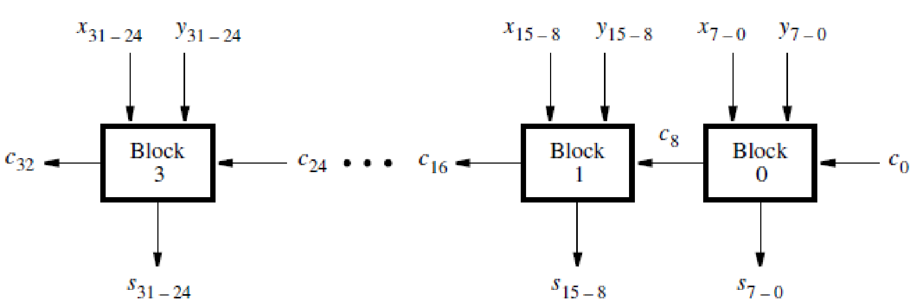
A hierarchical carry-lookahead adder with ripple-carry between blocks.

Slide 29
gi, pi : 1 gate delay
c1-c8 : 2 gate delay
c9-c16 : 2 gate delay
c17-c24 : 2 gate delay
c25-c32 : 2 gate delay
One more gate delay to produce the sum bits from the last block (by XOR gate in second level adder, this XOR gate delay is not to be seen in first level as modified adders are used.)
Total : 10 gate delays.

Slide 30
Instead of using a ripple-carry approach between blocks, a faster circuit can be designed in which a second-level carry-lookahead is performed to produce quickly the carry signals between blocks. The structure of this “hierarchical carry-lookahead adder” is shown in the figure below

Slide 31
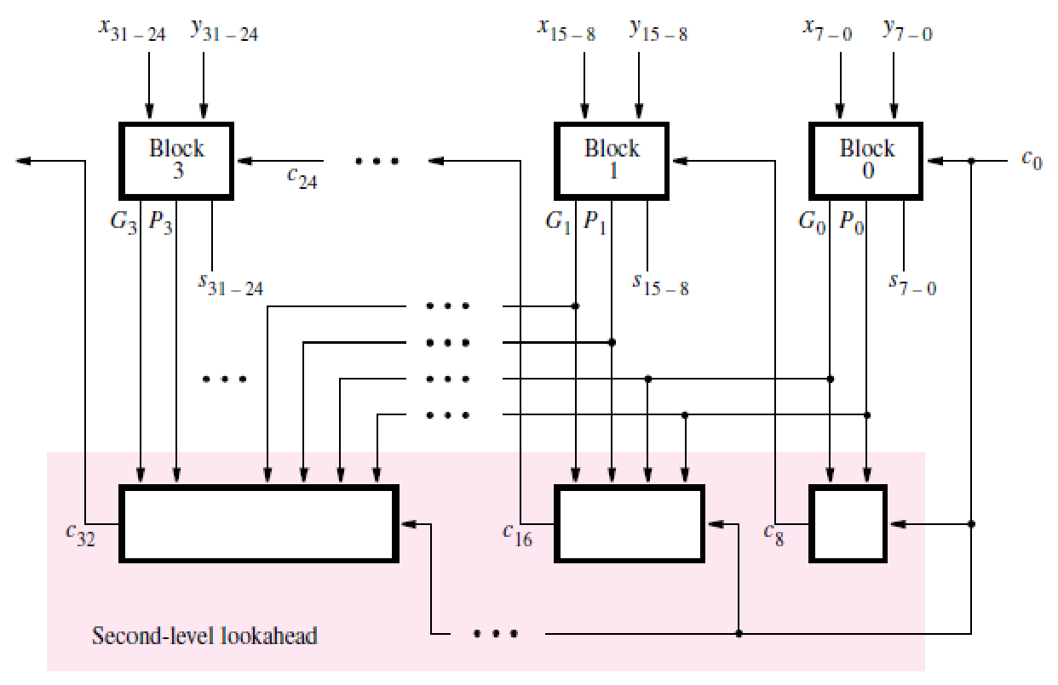
A hierarchical carry-lookahead adder.

Slide 32
Each block in the top row includes an eight-bit carry-lookahead adder, based on generate and propagate signals for each stage in the block.
Instead of producing a carry-out signal from the most-significant bit of the block, each block produces generate and propagate signals for the entire block. Let Gj and Pj denote these signals for each block j.
Now Gj and Pj can be used as inputs to a second-level carry-lookahead circuit at the bottom of the Figure, which evaluates all carries between blocks.
We can derive the block generate and propagate signals for block 0 by examining the expression for c8

Slide 33
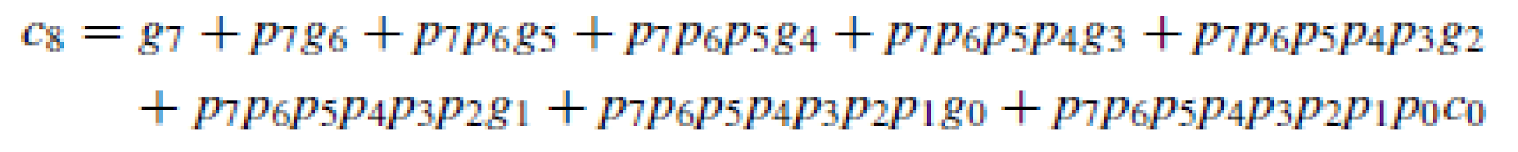
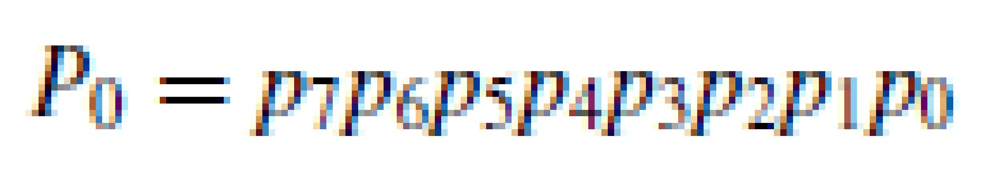
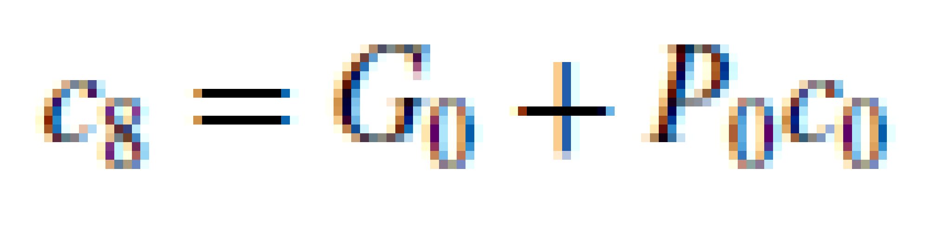
For block 1 the expressions for G1 and P1 have the same form as for G0 and P0 except that each subscript i is replaced by i + 8. The expressions for G2, P2, G3, and P3 are derived in the same way. The expression for the carry-out of block 1, c16, is

Slide 34
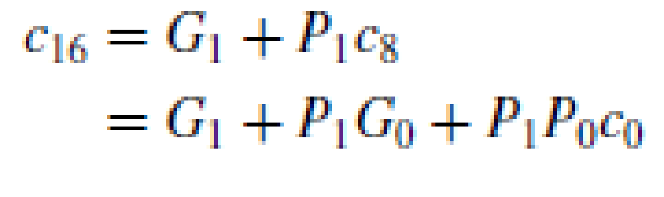
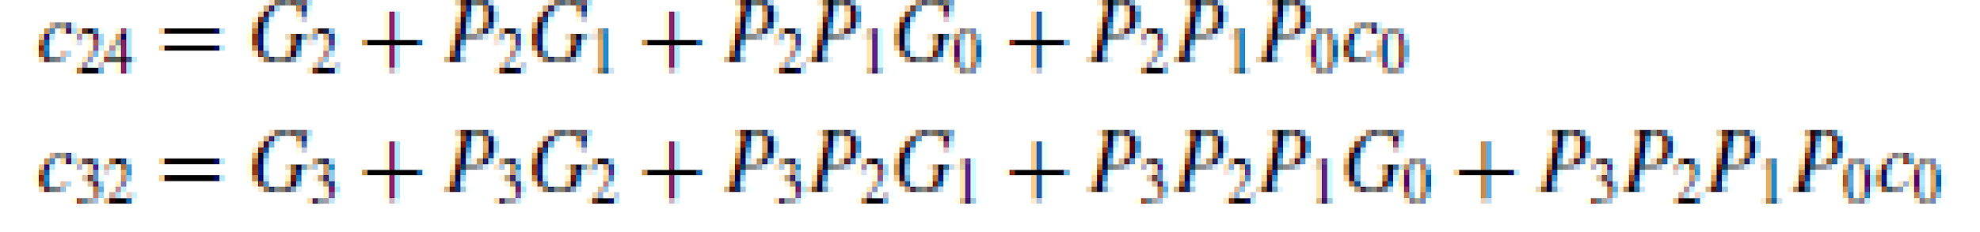
Similarly, the expressions for c24 and c32 are

Slide 35
Using this scheme, it takes two more gate delays to produce the carry signals c8, c16, c24, and c32 than the time needed to generate the Gj and Pj functions. Therefore, since Gj and Pj require three gate delays, c8, c16, c24, and c32 are available after five gate delays. The time needed to add two 32-bit numbers involves these five gate delays plus two more to produce the internal carries in blocks 1, 2, and 3, plus one more gate delay (XOR) to generate each sum bit. This gives a total of eight gate delays.
It takes 2n + 1 gate delays to add two numbers using a ripple-carry adder. For 32-bit numbers this implies 65 gate delays. It is clear that the carry-lookahead adder offers a large performance improvement.

